Slide 1
Silver State Health Insurance Exchange
Navigator/EEF PHE Unwinding Info Session
April 18, 2023

Slide 2
Agenda
Introductions
OEP Metrics & Successes PY23
Unwinding of the PHE
Key Messages
Coordination w/ Medicaid – PHE Messaging
NV Health Link SEP
Notifying Consumers
Resources for you
Q&A

Slide 3
Introductions
Janel Davis, Chief Operations Officer
j-davis@exchange.nv.gov
Shae Herbert, Quality Assurance Manager
sherbert@exchange.nv.gov
Rosa Alejandre, Nav Program Manager
rlomazzo@exchange.nv.gov
Tracy Reed, BPA 1, QA team, Broker/Nav focus
treed@exchange.nv.gov
Georgina “Gina” Castaneda, Policy & Compliance Manager
gcastaneda@exchange.nv.gov

Slide 4
Open Enrollment Plan Year 2023 Metrics & Successes
2nd highest enrollment year at 96,379 enrollees
New enrollees: 19,410
Active re-enrollees: 13,602
Qualified Dental Plan Enrollments: 17,229
VSP Vision plan enrollments: 308
Press Event at SNV Health District
“Our Plans are Made for Your Plans” campaign
M4C Studies & Surveys
Focus on hard-to-reach populations
Improve the consumer journey on NVHL.com
Notes:
Strategy for marketing campaign: The Abbi Agency worked in lockstep with The Silver State Health Insurance Exchange (Exchange), the state agency connecting Nevadans to affordable Qualified Health Plans, to prepare Nevadans to sign up for health insurance coverage during PY23 Open Enrollment Period. The creative campaign was an evolution of the PY22 campaign focused on connecting health insurance to the individual lives of Nevadans and repeating the key messages of Motivation, Help, Value, Authentic and Flexible. Campaign assets were created with real Nevadans to ensure that authenticity was central to all campaign outreach.
Surveys – M4C: Marketing for Change administered online surveys to Nevadan residents immediately after both the 2022 and 2023 Open Enrollment Periods. Goals: Assess statewide awareness/favorability of NVHL, exposure to OEP messaging campaign, and estimates of uninsured and self-insured in the state post OEP.
2022 Key findings: ○ The majority of respondents gave an overall positive evaluation of NVHL ○ Exposure to the 2022 OEP messaging campaign predicted purchasing health insurance during the 2022 OEP ○ 4 out of 5 participants rated their shopping experience as “easy” or “fairly easy” ○ Participants who rated their shopping experience as more difficult cited issues with comparing multiple plans and lack of clear instructions or explanation of coverage ○ Positive reactions to their premium was highly predictive of overall positive views of NVHL.
The Abbi Agency integrated highly effective tactics to target hard to reach communities and the general target audiences. In addition, we leveraged data provider partnerships and census data to reach diverse communities across the state and rural areas.
The Abbi Agency administered several updates to improve the customer’s journey on NevadaHealthLink.com. Our Digital Experience team implemented a consumer-focused engagement strategy for the campaign, with landing pages in both English and Spanish.

Slide 5
Understanding Data Matching Issues (DMIs)
Verification(s) are checked every time an application is submitted. Every Nov. 1st of each year, and twice a year at periodic times
If application information is “inconsistent with trusted data sources”
DMIs will be generated for each inconsistency found
Customer is “conditionally eligible” for coverage for 90-day reasonable opportunity period (ROP)
Inconsistencies must be resolved before end of ROP or else adverse action will be taken
Since eligibility is determined at the individual family member level, most DMIs are applicable to a specific person not the entire HH
NOTE: Income is for the entire HH, income DMIs are based on the entire household’s income (even though we list the income DMI under the primary tax filer’s name)
If income DMI is not resolved by end of ROP, APTC/CSR terminated for entire HH affective last day of the month or after ROP expires (90-day ROP + 15 days).
Notes:
NV Health Link is required by federal law to verify information on a customer’s application against trusted data sources and flags called Data Matching Issues (DMI).

Slide 6
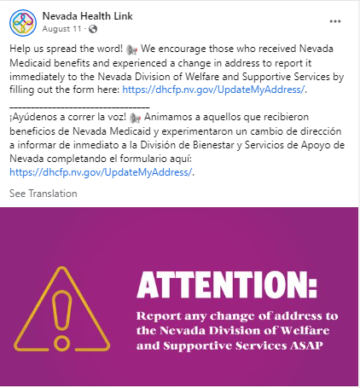
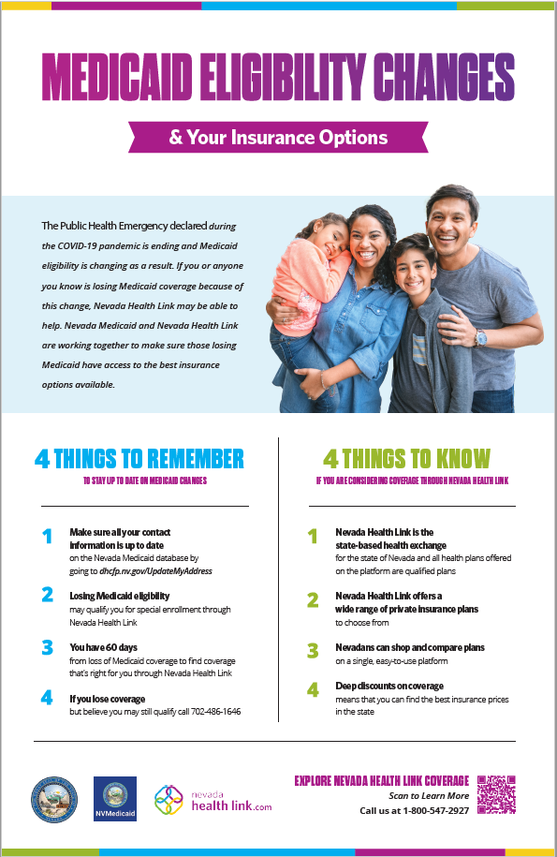
Let’s Talk PHE Unwinding
In 2020, The U.S. Department of Health & Human Services declared the U.S. to be in a Public Health Emergency (PHE). When the PHE ends (date yet to be determined), Nevadans enrolled in Medicaid will need to take action to renew their coverage and not lose health insurance. Nevada Health Link is working closely with Nevada Medicaid to inform Nevadans about renewing their coverage and exploring health insurance options if they no longer qualify for Medicaid.
What we’ve done so far:
Print & distribute poster to our community partners
Paid Social Media Posts
Updated Medicaid Information Page: https://www.nevadahealthlink.com/medicaid-information/
Partner Toolkit: https://www.nevadahealthlink.com/toolkits/
PHE Unwinding Blog: https://www.nevadahealthlink.com/insurance/pandemic-resources-could-end-soon-heres-what-you-need-to-know-about-your-continuous-coverage-options/
Nevada is ahead of the curve in preparing for the unwinding:
1. State’s unwinding plan or a summary
2. Specific info about unwinding
3. Alert to update contact info
4. Communications materials/ toolkits for partners
5. Unwinding FAQ
6. Unwinding data
https://ccf.georgetown.edu/2022/09/06/state-unwinding-tracker/
Notes:
From a marketing perspective, the Exchange has been working with Medicaid and contracted marketing vendor, The Abbi Agency, for a couple years. Now that timelines are nailed down, we’ve produced some helpful resources. On this slide, I’ve outlined the work the Comms team and NV State Medicaid have already worked on thus far in keeping the public up to date and making sure the Exchange and Medicaid get the correct and updated contact information for the consumers potentially losing their Medicaid benefits.

Slide 7
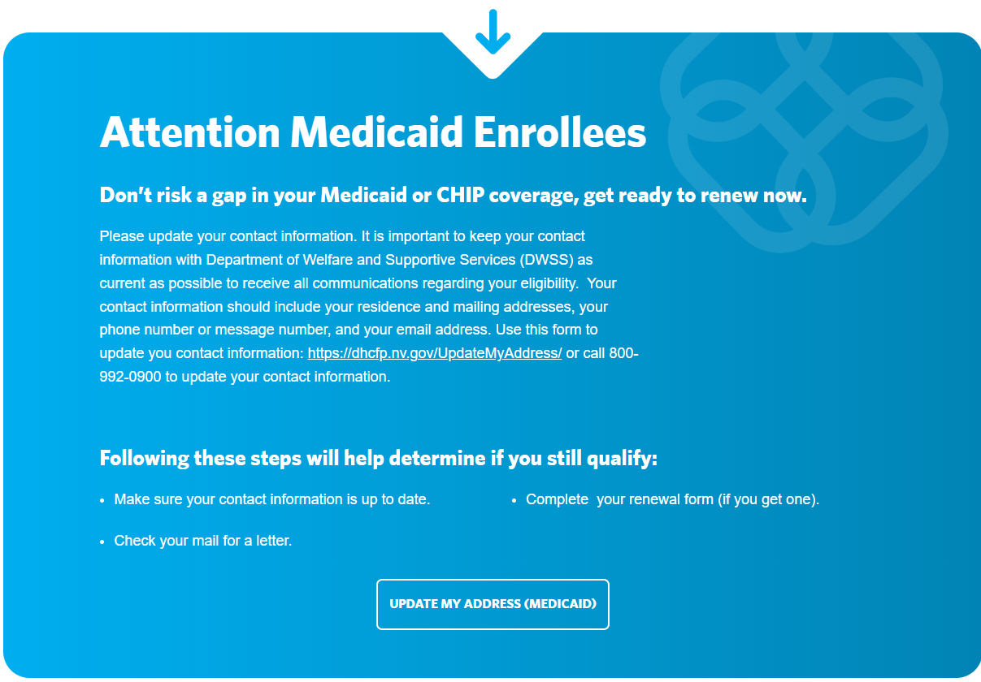
Key Messages
Changes are coming to Nevada Medicaid, and coverage will need to be renewed soon!
NV Medicaid recipients will need to complete a renewal pkt (redetermination mailed packet) from Nevada Medicaid.
These packets will arrive between April 2023 and April 2024.
NV Medicaid hasn’t paused their redetermination schedule; they just have not taken any adverse action during the PHE.
The expected volume of those redetermined ineligible out of ~930k is ~200k.
Notes:
For most Nevada Medicaid members, DWSS will restart renewals over a 12-month timeframe based on the member’s annual renewal timeline. Not everyone will be up for renewal at the same time.
DWSS will conduct the renewal process by first doing its ex parte process. Ex parte is also known as auto-renewal, passive renewal or administrative renewals similarly what NV Health link does during renewals.
For example, if the household is due for renewal June 2023. The ex parte will be ran on March 15.
If the household was successfully verified via the ex parte process, a notice of continued coverage until June 2024 will be sent to the household.
If the household was not verified via the exparte process then a paper renewal packet will be sent in April and it will be due back to the Medicaid office May 31, 2023.
If the household does return the renewal packet and they are determined OVER INCOME which is considered found ineligible for continues coverage. They will get a notice in the mail NV Medicaid coverage is scheduled to end. They can appeal the decision if they believe it is not correct. Appeal and fair hearing rights and instructions for filing an appeal will be on the notice they will get then the Account Transfer (AT) process will happen 5 days after they are determined. They will receive a notice if they are referred to NV Health Link and to claim their account.
If renewal packets are not returned by the due date then they will lose coverage June 1, 2023. BUT they can return the renewal packet up to 90 days after and if they still qualify they will be reinstated.
How do Medicaid enrollees find out their renewal date? Enrollees are sent their Renewal date a few different times. They receive it initially on their approval letter. Second, we send the reminder of their Renewal date on their Renewal paperwork. This time we also explain that if we do not receive their renewal paperwork, their eligibility may end.
Is it available on Access NV? Households/Individuals who have a linked Access Nevada account (linked means they verified their identity and are receiving electronic notices from DWSS to their Access Nevada account) will receive copies of their renewal paperwork in their inbox/to-do-list.
Do they call in? The DWSS automated Voice response Unit (VRU) can provide information on renewal dates. The system is up and available 24hrs a day.
Visit a Medicaid Office? Yes, individuals who enter a DWSS or DHCFP district office can ask for their current renewal date. DWSS office can also provide copies of the renewal paperwork.

Slide 8
Coordination With NV State Medicaid – Marketing & Messaging
Exchange Media tactics include billboards, social media and Google ads targeted towards individuals who likely are on Medicaid (coordinating zip code targeting and account transfer data).
PHE toolkit that is printed and digital
The co-branded toolkit includes a poster, flyer and rack card
Digital toolkit includes social media posts and talking points.
Outreach to physicians and hospitals
Notes:
Due to Medicaid limited marketing and outreach budgets, the Exchange has spent about $30k thus far on paid media efforts to reach Nevadans with messaging encouraging them to update their contact information with Medicaid to be prepared for changes as a result of the PHE unwinding. Media tactics include billboards, social media and Google ads targeted towards individuals who likely are on Medicaid (coordinating zip code targeting and account transfer data). We have also created a PHE toolkit that is printed and digital. The physical toolkit includes a poster, flyer and rack card that we created co-branded with Medicaid that includes high level information on the unwinding and steps Medicaid enrollees need to make to continue coverage options. The digital toolkit includes social media posts and talking points. Both toolkits are in English and Spanish. For 2023, the Exchange’s marketing and comms team plan to continue about 10% of the advertising on PHE education. The Exchange plans to increase the paid mediate budget to about 25% of our special enrollment budget. At that time, we will explore more outreach opportunities such as events, social media, Facebook live recordings, grocery store ambassadors, etc. We are also going to do outreach to physicians and hospitals so if people realize they don’t have insurance while they are at the doctor, they will be given information about Nevada Health Link’s affordable health insurance options.

Slide 9
NV Health Link SEP for the Unwinding
Consumers who lose Medicaid or CHIP coverage between April 1, 2023, and July 31, 2024, will be eligible for a 60-day SEP beginning the day they submit or update a NV Heath Link application. Consumers will receive the Unwinding SEP automatically based on their answers to the application questions.
For consumers who report a loss of Medicaid or CHIP coverage in the past, Marketplace coverage will start the first of the month following plan selection. For example, if a consumer selects a plan on August 25, coverage will start September 1.
For consumers who are transferred from Medicaid to the Exchange via the AT process, those consumers may choose retroactive coverage.
Medicaid/Chip Coverage End Date | Date of Exchange Plan Selection | Exchange Plan Effective Date
July 31, 2023 | July 25, 2023(before Medicaid coverage ends) | August 1, 2023
July 31, 2023 | August 5, (after Medicaid Converge ends) | September 1, 2032
July 31, 2023 | September 2, (after Medicaid coverage ends | August 1, 2023 with paid past due premiums or October 1, 2023.
Notes:
Due to the unprecedented nature of unwinding, during which consumer may need additional time to transition to exchange coverage. Nevada Health link will offer a temporary SEP referred to as the Unwinding or on our platform “Loss of Medicaid/CHIP”
Consumers who lose Medicaid or CHIP coverage between April 1, 2023 and July 31, 2024 will be eligible for a 60 day SEP beginning the day they submit or update a NV Heath Link platform application.
For consumers who are who are transferred from Medicaid to the exchange via the AT process for over income, those consumers may choose retroactive coverage up to their Medicaid end date. NV Health link is currently working with Medicaid's vendor to be able to obtain the Medicaid end date. If consumers are able to choose a retro active start date the prior months premiums need to be paid. If they are not then they will have a first of the month following plan selection.
Its key to understand that this SEP after an account is created or an account is claimed a consumer will only have 60 days to select a plan.

Slide 10
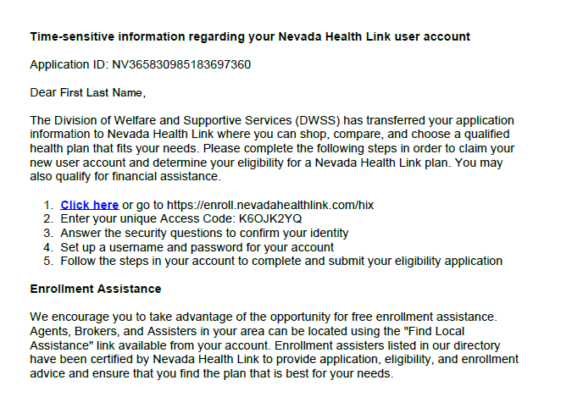
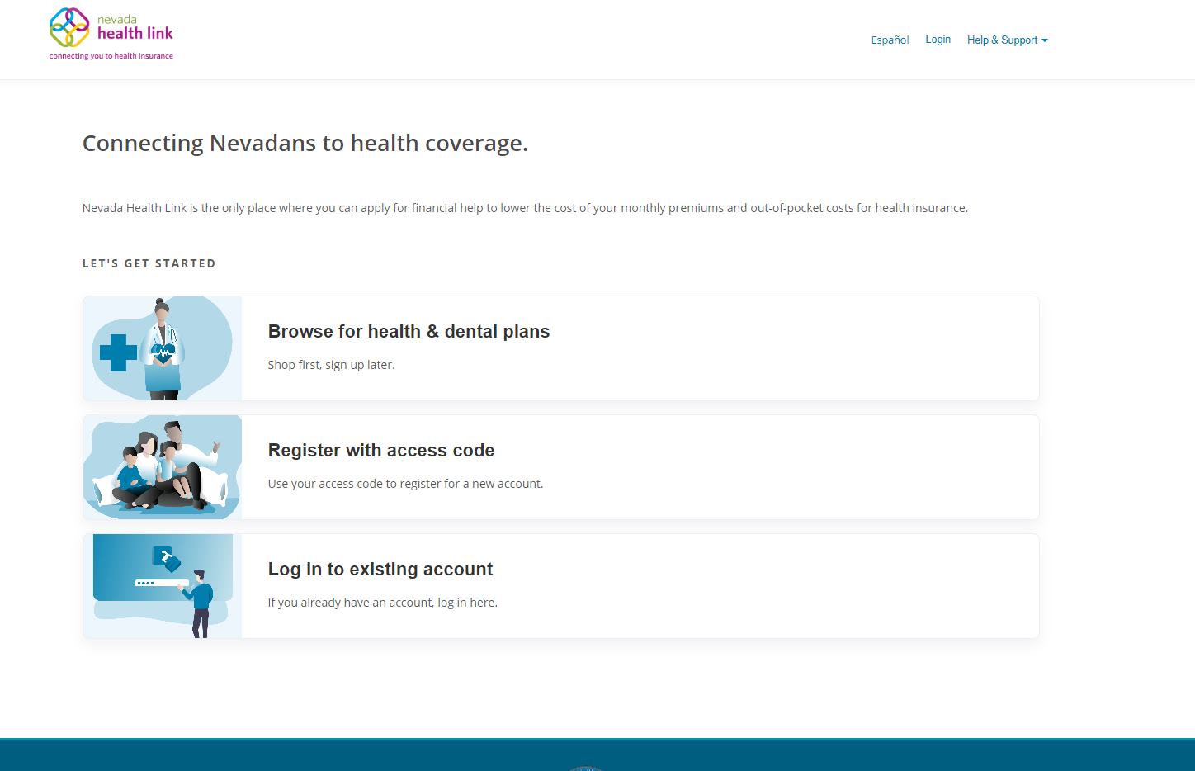
Process to Notify Beneficiaries
NV State Medicaid sends redetermination packets in the mail and via email May 1, 2023
June 30th is final day of eligibility for unresponsiveness
SSHIX call center CSRs making outbound calls to consumers during PHE unwinding period starting around May 1
MCOs are conducting outreach to Nevadans
Notes:
Medicaid Redetermination packets are mailed May 1. If paper renewal packets are not received by June 15, 2023, a Notice of Decision is sent automatically advising that eligibility will end if no contact or renewal packet is received.
If eligibility renewal packet is determined ineligible for Medicaid, starting July 1, consumer will have 90 days after July 1st to submit the completed renewal packet to be re-evaluated.

Slide 11
Resources for You
Navigator Newsletter – Read them, they’re important
Partner Toolkits: https://www.nevadahealthlink.com/toolkits/#public-health
Reference Materials & Tools Navs/IPAs: https://www.nevadahealthlink.com/partner-resources/
PHE Webpage, coming soon, now directing to: https://www.nevadahealthlink.com/medicaid-information/

Slide 12
Questions/Feedback
???
Thank you for your participation and helpful feedback!
Janel Davis
Chief Operations Officer
Silver State Health Insurance Exchange
j-davis@exchange.nv.gov
775-687-9934
775-434-9008

